Slide 1
Linear Regression:
Mother of all Predictive Models
Data Science HYD
Oct-Nov 2018

Slide 2
Prediction Problem
Insurance companies collect data on applicants’ demographic and income profile to make an estimate whether the applicant will default in payment
Based on footfall, pricing, sale, season of the year, stores estimate sales figures
Based on industrial growth, GDP growth, residential consumption pattern of electricty, Govt determines whether a new power station needs to be built
Based on various features of a car, its MPG performance may be determined
Response and Predictors

Slide 3
What is Regression?
Linear regression is an approach for modeling the relationship between a dependent variable Y and one or more explanatory variables (or independent variables) denoted by X.
The case of one explanatory variable is called Simple Linear Regression. (SLR)
For more than one explanatory variable, the process is called Multiple Linear Regression. (MLR)

Slide 4
More Examples?
Software project time estimation?
Marketing?
Finance?
Supply chain?
Elsewhere?

Slide 5
Simple Linear Regression: Continuous Response One Predictor

Slide 6
Auto Data
Description
Mpg: miles per gallon (Y: Response)
Cylinders: Number of cylinders (between 4 and 8)
Displacement: Engine displacement (cu. inches)
Horsepower: Engine horsepower
Weight: Vehicle weight (lbs.)
Acceleration: Time to accelerate from 0 to 60 mph (sec.)

Slide 7
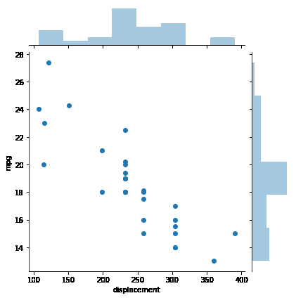
What is Regression?
Can we know MPG
performance of a car
whose displacement
is known to us?

Slide 8
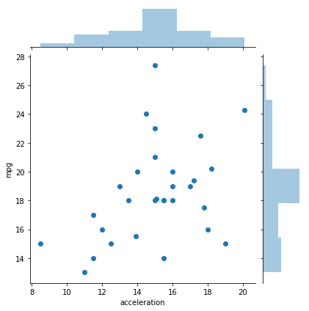
Example: Auto Data
r = -0.86
r = 0.40

Slide 9
Correlation
Correlation is a measure of strength of relationship between pair of variables
In common usage it refers to the extent to which two variables have a linear relationship with each other
Denoted by ρ or r
Ranges from -1.0 to +1.0
The closer r is to +1 or -1, the more closely the two variables are related
If r is close to 0, it means there is no linear relationship between the variables

Slide 10
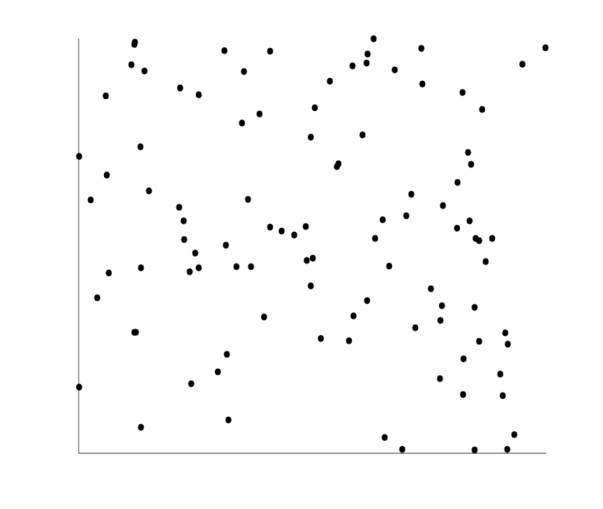
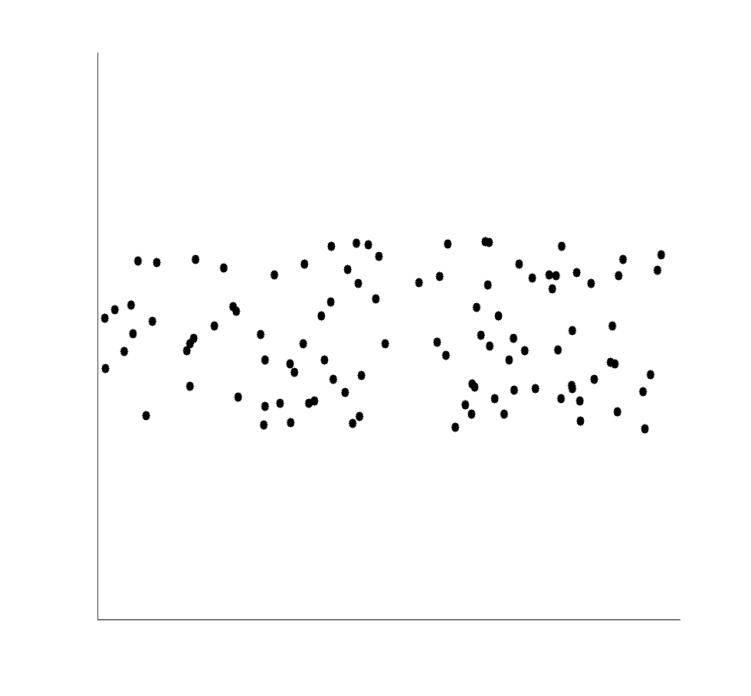
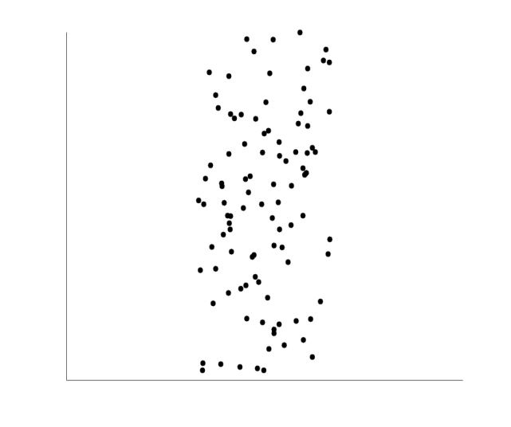
Uncorrelated Data

Slide 11
Pairwise Correlations
 | mpg | cylinders | displacement | horsepower | weight | acceleration
mpg | 1 | -0.85 | -0.86 | -0.75 | -0.78 | 0.41
cylinders | -0.85 | 1 | 0.94 | 0.82 | 0.81 | -0.55
displacement | -0.86 | 0.94 | 1 | 0.83 | 0.83 | -0.48
horsepower | -0.75 | 0.82 | 0.83 | 1 | 0.76 | -0.74
weight | -0.78 | 0.81 | 0.83 | 0.76 | 1 | -0.24
acceleration | 0.41 | -0.55 | -0.48 | -0.74 | -0.24 | 1

Slide 12
Correlation - Regression
Correlation and regression are closely related in concept
Correlation is limited in scope
Regression more versatile and flexible
Correlation does not provide a structure of dependence
Regression provides a model
Correlation is only pairwise
Regression can handle multiple predictors in a joint environment

Slide 13
Fuel Efficiency of a Car
For car buyers fuel efficiency is an important consideration
Petrol is expensive
Environmental concerns
Fuel economy may lead to compromise on ride quality
Important to understand what will be estimated fuel efficiency for different types of cars

Slide 14
Auto Data Can mpg be estimated as a linear function of displacement? mpg = α + β displacement

Slide 15
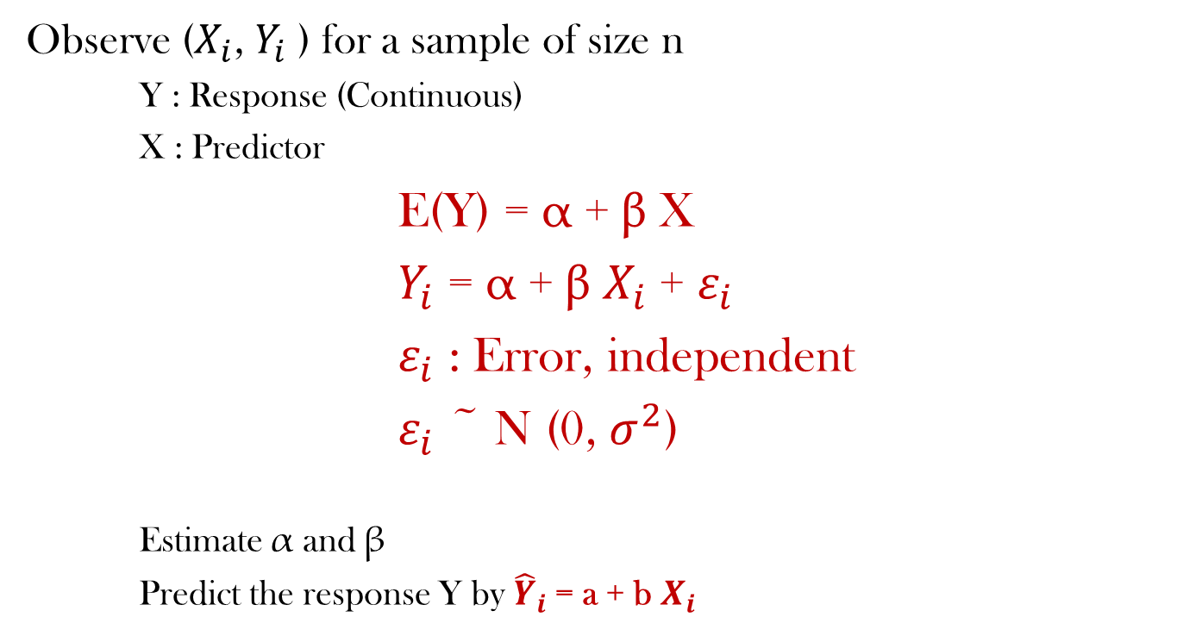
Simple Linear Regression
Observe ($X_{i}$, $Y_{i}$ ) for a sample of size n
Y : Response (Continuous)
X : Predictor
E(Y) = α + β X
$Y_{i}$ = α + β $X_{i}$+ $ε_{i}$
$ε_{i}$ : Error, independent
$ε_{i}$ ~ N (0, $σ^{2}$)
Estimate α and β
Predict the response Y by ${\hat{Y}}_{i}$= a + b $X_{i}$

Slide 16
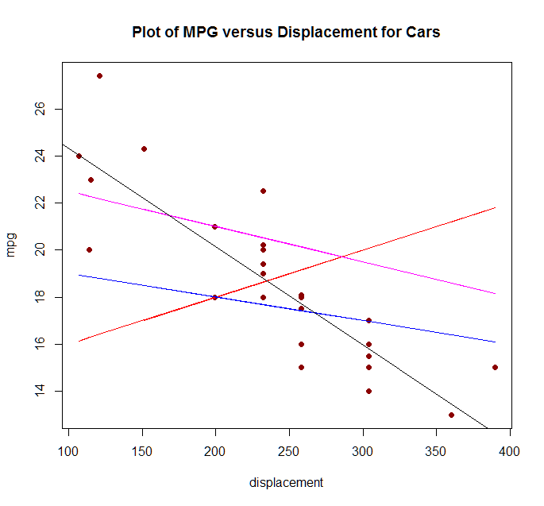
Which Line?
Line of best fit

Slide 17
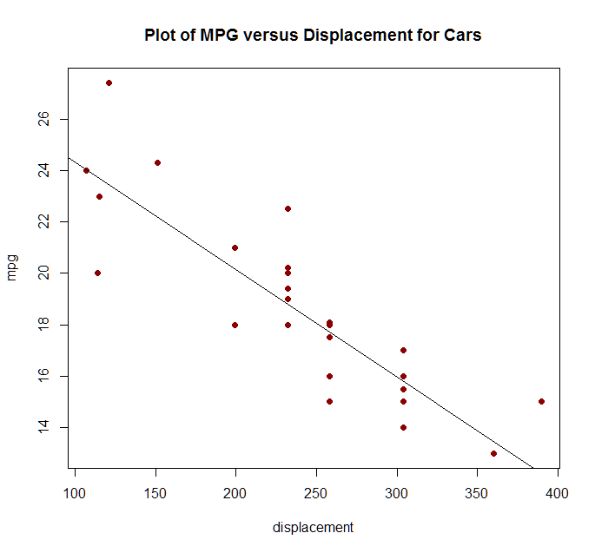
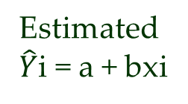
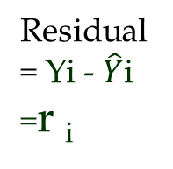
Error in Regression
Regression Model
Yi = α + βxi + εi
E(Yi) = α + βxi
εi ~ N(0, σ²)
Estimated
$\hat{Y}$i = a + bxi
Residual
= Yi - $\hat{Y}$i
=r _{i}

Slide 18
Fuel Efficiency of a Car: Displacement
coef std err t P>|t| [0.025 0.975]
--------------------------------------------------------------------------------
const 28.5089 1.179 24.188 0.000 26.095 30.923
displacement -0.0418 0.005 -8.829 0.000 -0.051 -0.032
=====================================================
R-squared: 0.736
F-statistic: 77.96
Prob (F-statistic): 1.39e-09
No. Observations: 30
Df Residuals: 28
Df Model: 1

Slide 19
Fuel Efficiency of a Car: Displacement
Intercept (a)
Slope (b)
Sign of slope
Sign of correlation coefficient
For unit increase is displacement mpg changes by how much?
Compare two cars: displacement 360 and 232. What will be difference between expected mpg?
What are the actual mpg?
Why the difference?
For a new car with displacement 300 will we know exact mpg?
For a new car with displacement 500 can we estimate mpg?

Slide 20
Fuel Efficiency of a Car
Regress mpg on horsepower
Regress mpg on weight
Regress mpg on acceleration

Slide 21
Fuel Efficiency of a Car: HP
R-squared: 0.562
F-statistic: 35.92
Prob (F-statistic): 1.86e-06
No. Observations: 30
Df Residuals: 28
Df Model: 1

Slide 22
Fuel Efficiency of a Car: Weight
Call:
lm(formula = mpg ~ weight, data = Auto)
Residuals:
Min 1Q Median 3Q Max
-2.8887 -1.7401 -0.1255 1.0009 5.9506
Coefficients:
Estimate Std. Error t value Pr(>|t|)
(Intercept) 35.8456229 2.6775772 13.39 1.08e-13 ***
weight -0.0053918 0.0008232 -6.55 4.22e-07 ***
---
Signif. codes: 0 ‘***’ 0.001 ‘**’ 0.01 ‘*’ 0.05 ‘.’ 0.1 ‘ ’ 1
Residual standard error: 2.151 on 28 degrees of freedom
Multiple R-squared: 0.6051, Adjusted R-squared: 0.591
F-statistic: 42.91 on 1 and 28 DF, p-value: 4.22e-07

Slide 23
Fuel Efficiency of a Car: Acceleration
Call:
lm(formula = mpg ~ acceleration, data = Auto)
Residuals:
Min 1Q Median 3Q Max
-5.6133 -1.8768 -0.3501 1.4241 8.9104
Coefficients:
Estimate Std. Error t value Pr(>|t|)
(Intercept) 10.5258 3.4051 3.091 0.00448 **
acceleration 0.5309 0.2236 2.374 0.02467 *
---
Signif. codes: 0 ‘***’ 0.001 ‘**’ 0.01 ‘*’ 0.05 ‘.’ 0.1 ‘ ’ 1
Residual standard error: 3.124 on 28 degrees of freedom
Multiple R-squared: 0.1676, Adjusted R-squared: 0.1379
F-statistic: 5.638 on 1 and 28 DF, p-value: 0.02467

Slide 24
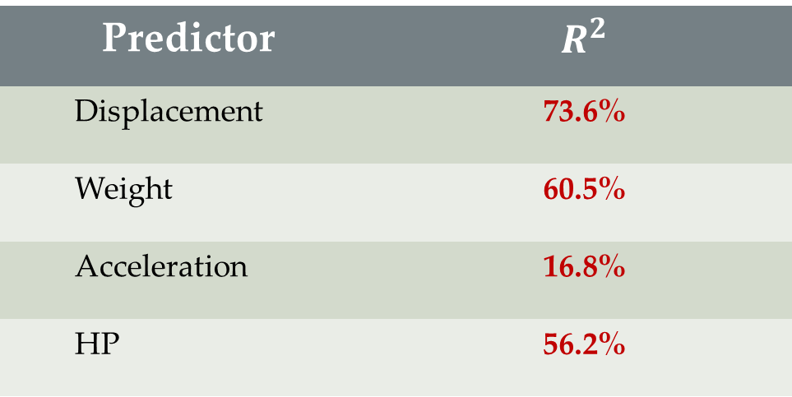
Fuel Efficiency of a Car
If only one predictor is to be used to predict fuel efficiency of a car which one should be used?
Predictor | $$R^{2}$$
Displacement | 73.6%
Weight | 60.5%
Acceleration | 16.8%
HP | 56.2%

Slide 25
On Your Own!

Slide 26
Insurance Claim vs GDP
district | The data is collected at the district level. There are 620 districts.
region | Each of the four regions, North, East, West, and South has 155 districts
Spend type | Spend type is classified into Public and Insurance. It is assumed here that public expenditure is borne by the government and is used for treating uninsured people. People with insurance do not use any public expenditure. These two groups are therefore mutually exclusive.
percapgdp | Per capita gdp of the district
avgcancerspend | Average spend on cancer by public and insurance systems per patient
avgheartspend | Average spend on heart by public and insurance systems per patient
avgorganspend | Average spend on organ treatment by public and insurance systems per patient

Slide 27
Insurance Claim vs GDP
Insurance companies want to know whether insurance spend depends on per capita GDP?
Regress avgcancerspend on percapgdp
Regress avgheartpend on percapgdp
Regress avgorganpend on percapgdp

Slide 28
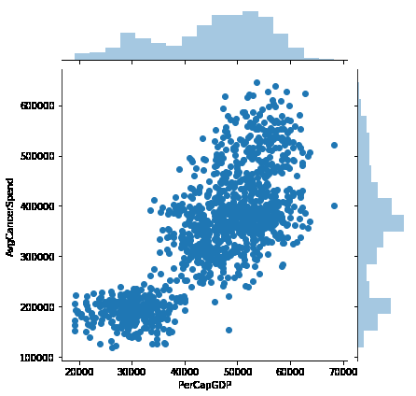
Insurance Claim vs GDP: Scatterplots
r = 78%

Slide 29
Insurance Claim vs GDP
===================================================================
coef std err t P>|t| [0.025 0.975]
----------------------------------------------------------------------------------
const 2.081e+04 582.763 35.702 0.000 1.97e+04 2.19e+04
AvgCancerSpend 0.0697 0.002 43.816 0.000 0.067 0.073
No. Observations: 1240
Df Residuals: 1238
Df Model: 1
R-squared: 0.608

Slide 30
Insurance Claim vs GDP
Is there a dependency of insurance claim due to cancer on per capita GDP?
What is the nature of dependency? If GDP increases by 10,000 mu (monetary unit), how much will insurance spend change?
Is GDP a sufficiently strong predictor to explain the change in insurance spend on cancer?

Slide 31
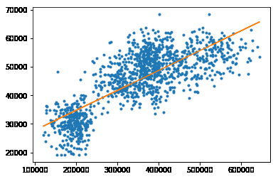

Slide 32
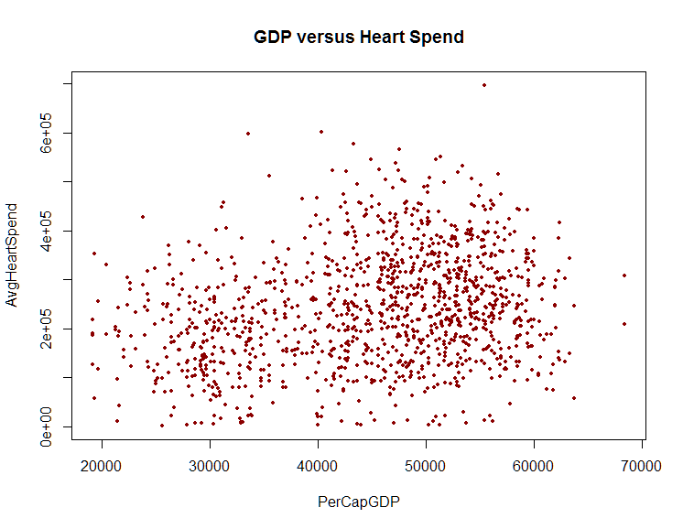
Insurance Claim vs GDP: Scatterplots
r = 24%

Slide 33
Insurance Claim vs GDP
Call:
lm(formula = AvgHeartSpend ~ PerCapGDP, data = Healthcare)
Residuals:
Min 1Q Median 3Q Max
-259619 -77640 -5572 74511 428422
Coefficients:
Estimate Std. Error t value Pr(>|t|)
(Intercept) 1.210e+05 1.395e+04 8.67 <2e-16 ***
PerCapGDP 2.652e+00 3.020e-01 8.78 <2e-16 ***
---
Signif. codes: 0 ‘***’ 0.001 ‘**’ 0.01 ‘*’ 0.05 ‘.’ 0.1 ‘ ’ 1
Residual standard error: 110100 on 1238 degrees of freedom
Multiple R-squared: 0.05862, Adjusted R-squared: 0.05786
F-statistic: 77.09 on 1 and 1238 DF, p-value: < 2.2e-16

Slide 34
Insurance Claim vs GDP
Is there a dependency of insurance claim due to heart on per capita GDP?
What is the nature of dependency? If GDP increases by 10,000 mu (monetary unit), how much will insurance spend change?
Is GDP a sufficiently good predictor to explain the change in insurance spend on heart?

Slide 35
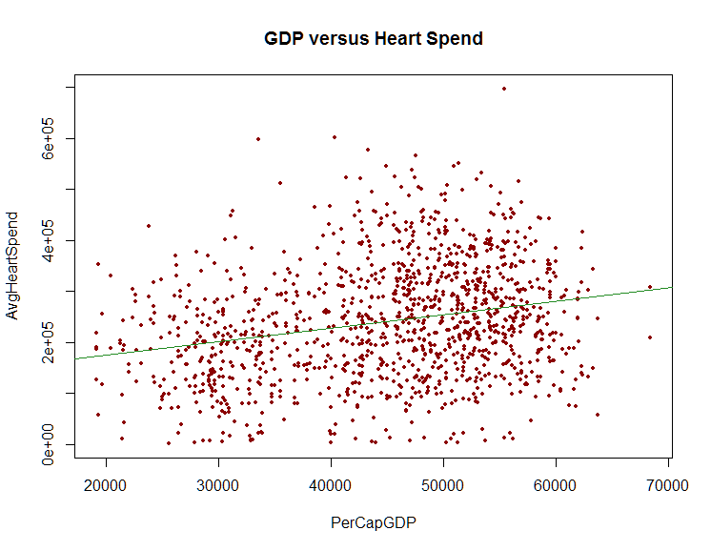

Slide 36
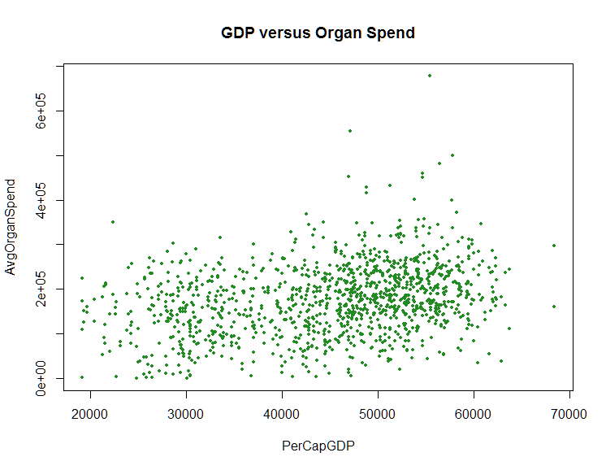
Insurance Claim vs GDP: Scatterplots
r = 30%

Slide 37
Insurance Claim vs GDP
Call:
lm(formula = AvgOrganSpend ~ PerCapGDP, data = Healthcare)
Residuals:
Min 1Q Median 3Q Max
-179065 -49499 -2391 46683 478758
Coefficients:
Estimate Std. Error t value Pr(>|t|)
(Intercept) 72661.890 9518.764 7.634 4.54e-14 ***
PerCapGDP 2.287 0.206 11.103 < 2e-16 ***
---
Signif. codes: 0 ‘***’ 0.001 ‘**’ 0.01 ‘*’ 0.05 ‘.’ 0.1 ‘ ’ 1
Residual standard error: 75120 on 1238 degrees of freedom
Multiple R-squared: 0.09055, Adjusted R-squared: 0.08982
F-statistic: 123.3 on 1 and 1238 DF, p-value: < 2.2e-16

Slide 38
Insurance Claim vs GDP
Is there a dependency of insurance claim due to organ on per capita GDP?
What is the nature of dependency? If GDP increases by 10,000 mu (monetary unit), how much will insurance spend change?
Is GDP a sufficiently good predictor to explain the change in insurance spend on organ?

Slide 39


Slide 40
Regression Residuals
Regression Model
Yi = α + βxi + εi
E(Yi) = α + βxi
εi ~ N(0, σ²)
Estimated
$\hat{Y}$i = a + bxi
Residual
= Yi - $\hat{Y}$i
=r _{i}

Slide 41
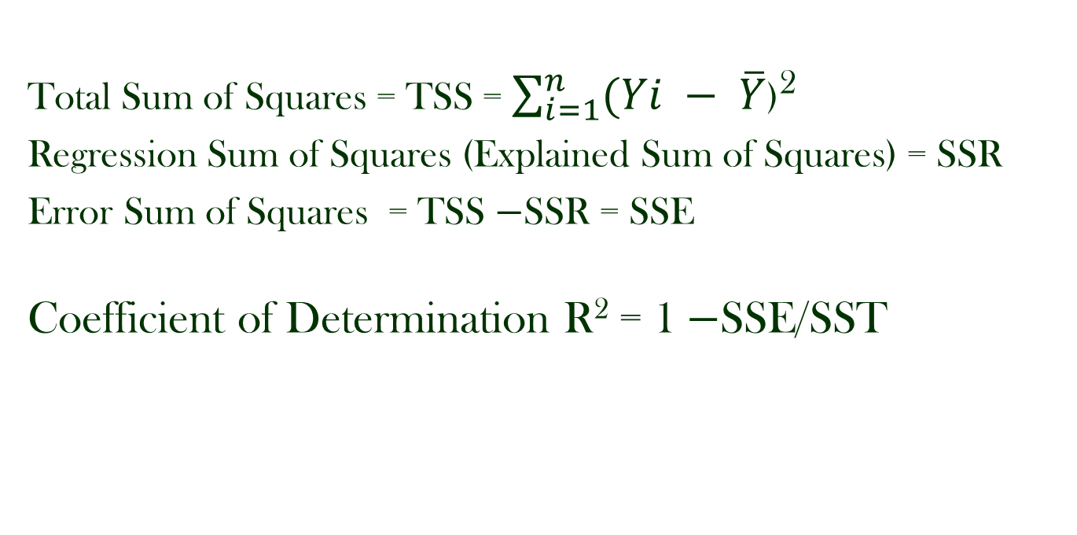
Regression ANOVA
Total Sum of Squares = TSS = $\sum_{i=1}^{n}{(Yi − \overline{Y}}$)²
Regression Sum of Squares (Explained Sum of Squares) = SSR
Error Sum of Squares = TSS −SSR = SSE
Coefficient of Determination R² = 1 −SSE/SST

Slide 42
Regression ANOVA
Residual extraction in R: $residuals
Fitted values in R: $fitted
ANOVA table gives a clue to the effectiveness of regression

Slide 43
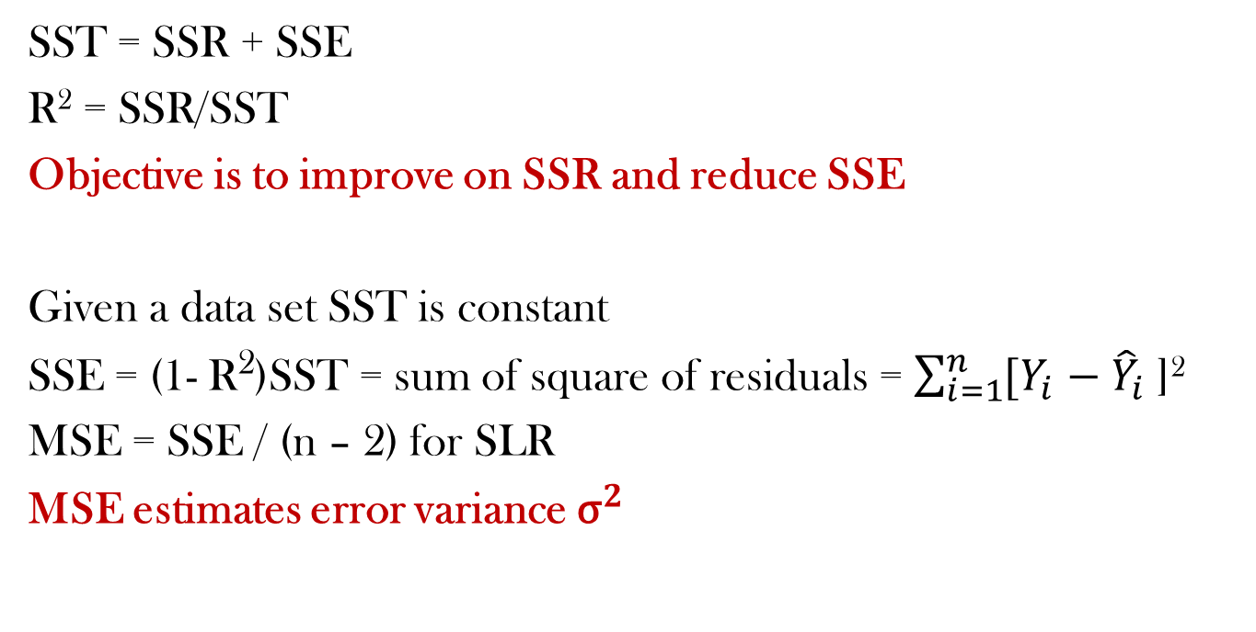
Regression ANOVA
SST = SSR + SSE
R² = SSR/SST
Objective is to improve on SSR and reduce SSE
Given a data set SST is constant
SSE = (1- R²)SST = sum of square of residuals = $\sum_{i=1}^{n}{[Y_{i}}$ − ${\hat{Y}}_{i}$ ]²
MSE = SSE / (n – 2) for SLR
MSE estimates error variance ${\text{σ}}^{2}$

Slide 44
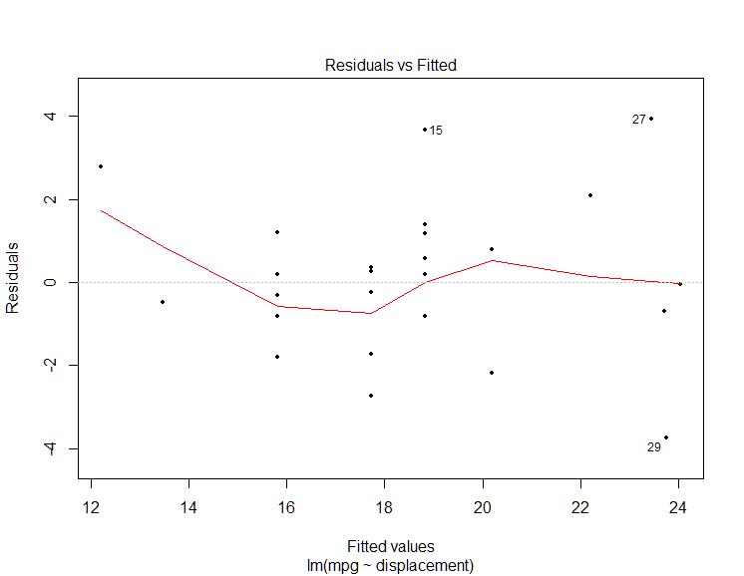
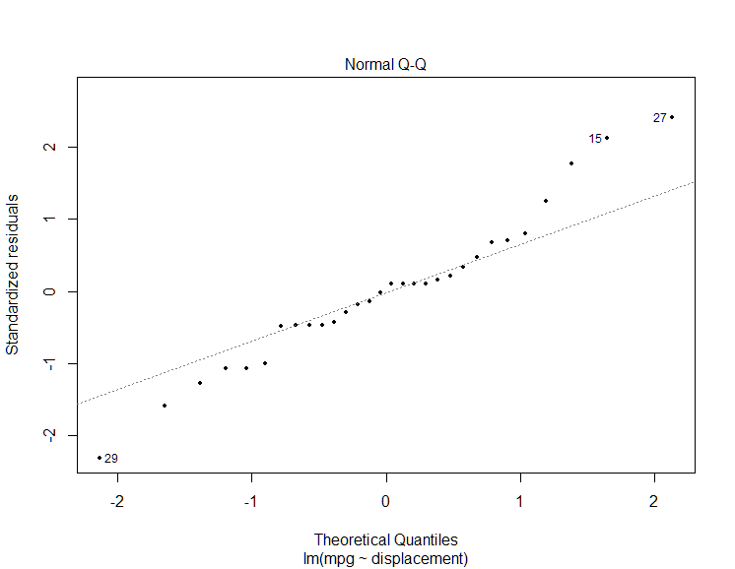
Testing Regression Assumptions
Mean of residuals is zero: (MPG on Displacement) 8.1e-17

Slide 45
Multiple Linear Regression: Continuous Response Two or More Predictors

Slide 46
Fuel Efficiency of a Car
So what happens if all the predictors are included in the model simultaneously?
Do we explain ALL variability in the data?
Do we get more than 100% R² value?
How do we explain dependency of mpg on predictors taken all at a time?

Slide 47
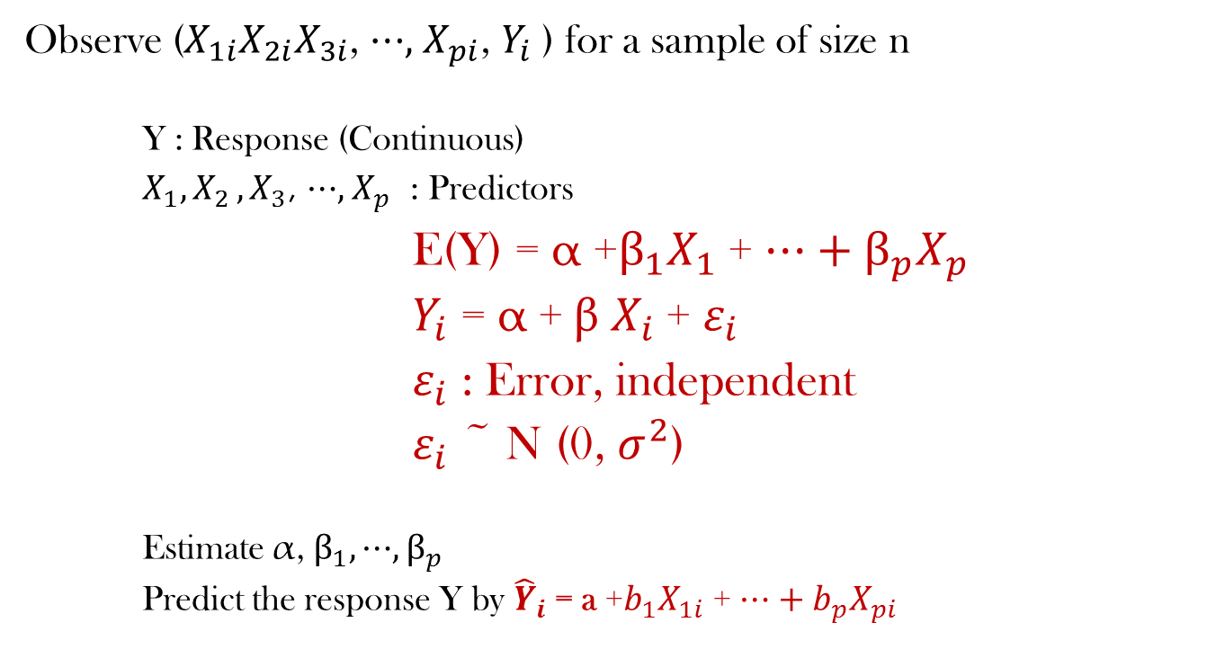
Multiple Linear Regression
Observe ($X_{1i}X_{2i}X_{3i}$, ⋯, $X_{pi}$, $Y_{i}$ ) for a sample of size n
Y : Response (Continuous)
$X_{1}{, X}_{2},X_{3}$, ⋯, $X_{p}$ : Predictors
E(Y) = α +$β_{1}X_{1}$ + ⋯ + $β_{p}X_{p}$
$Y_{i}$ = α + β $X_{i}$+ $ε_{i}$
$ε_{i}$ : Error, independent
$ε_{i}$ ~ N (0, $σ^{2}$)
Estimate α, $β_{1},\text{⋯}, β_{p}$
Predict the response Y by ${\hat{Y}}_{i}$= a +$b_{1}X_{1i}$ + ⋯ + $b_{p}X_{pi}$

Slide 48
Fuel Efficiency of a Car: Wt & HP
coef std err t P>|t| [0.025 0.975]
------------------------------------------------------------------------------
Intercept 34.4319 2.593 13.276 0.000 29.110 39.753
horsepower -0.0440 0.020 -2.193 0.037 -0.085 -0.003
weight -0.0034 0.001 -2.879 0.008 -0.006 -0.001
R-squared: 0.665 Adj. R-squared: 0.640
F-statistic: 26.78 Prob (F-statistic): 3.90e-07
No. Observations: 30
Df Residuals: 27
Df Model: 2

Slide 49
Fuel Efficiency of a Car: Wt & HP
Intercept (a)
Slopes (b1, b2)
Sign of slopes
Sign of correlation coefficients
For unit increase is weight mpg changes by how much? What happens with horsepower?
What are the fitted values?
For a car with hp=90 and weight=3200 can you get actual mpg?
For a car with hp=150 and weight=4260 can you get actual mpg?

Slide 50
Auto Data: Full Model
coef std err t P>|t|
--Intercept 34.7116 6.111 5.680 0.000
cylinders -0.9100 0.864 -1.053 0.303
displacement -0.0173 0.017 -1.044 0.307
horsepower -0.0203 0.042 -0.483 0.633
weight -0.0006 0.002 -0.329 0.745
acceleration -0.1418 0.323 -0.439 0.665
Multiple R-squared: 0.763
Adjusted R-squared: 0.714

Slide 51
Auto Data: Full Model

Slide 52
Auto Data: Full Model
Does the order of inclusion of the predictors in the model matters?
Should it matter?

Slide 53
Auto Data
Pairwise correlation among variables
 | mpg | cylinders | displacement | horsepower | weight | acceleration
mpg | 1 | -0.85 | -0.86 | -0.75 | -0.78 | 0.41
cylinders | -0.85 | 1 | 0.94 | 0.82 | 0.81 | -0.55
displacement | -0.86 | 0.94 | 1 | 0.83 | 0.83 | -0.48
horsepower | -0.75 | 0.82 | 0.83 | 1 | 0.76 | -0.74
weight | -0.78 | 0.81 | 0.83 | 0.76 | 1 | -0.24
acceleration | 0.41 | -0.55 | -0.48 | -0.74 | -0.24 | 1

Slide 54
Multicollinearity
If predictor variables are linearly related then the data is said to be multi-collinear
It is difficult to come up with reliable estimates of regression coefficients.
It will result in incorrect conclusions about the relationship between outcome variable and predictor variables.
Regression coefficients have high variance
Coefficients may have wrong sign
Extremely sensitive to slight change in data points
Prediction model becomes unreliable

Slide 55
Multicollinearity
Variance Inflation Factor (VIF) is the measure of multicollinearity
The VIF provides an index that measures how much the variance of an estimated regression coefficient is increased because of the multicollinearity
Ideally VIF should be close to 1
VIF > 5 indicates moderate multicollinearity
VIF > 10 indicates severe multicollinearity

Slide 56
VIF: Auto Data
VIF (set 1)
cylinders displacement horsepower weight acceleration
11.71 11.69 13.06 7.70 6.29
VIF (set 2)
cylinders displacement weight acceleration
10.47 9.76 3.82 1.70
VIF (set 3))
displacement weight acceleration
4.30 3.50 1.45
VIF (set 4)
weight acceleration
1.06 1.06

Slide 57
Auto Data: Final Model
Coefficients:
 | Estimate | Std. Error | t value | Pr(>|t|)
(Intercept) | 30.0293 | 3.8560 | 7.7880 | 2.25E-08 | ***
weight | -0.0050 | 0.0008 | -6.1970 | 1.26E-06 | ***
acceleration | 0.3028 | 0.1509 | 2.0070 | 0.0549 | .
Multiple R-squared: 0.6564
Adjusted R-squared: 0.6309

Slide 58
Auto Data: Final Model

Slide 59
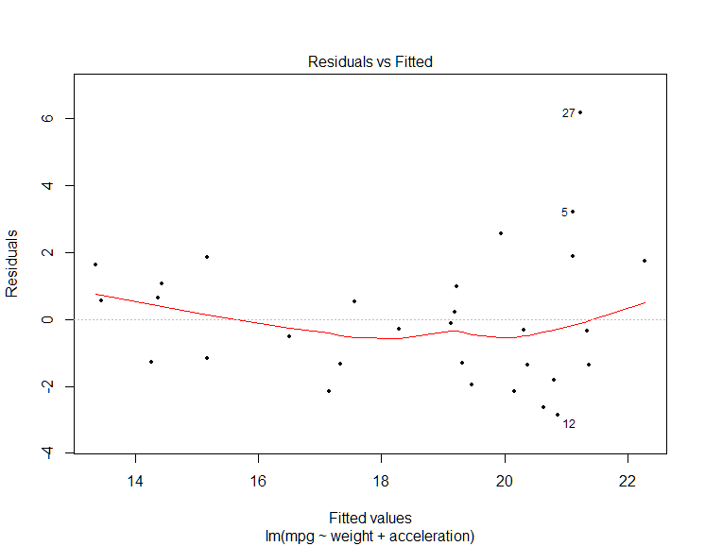
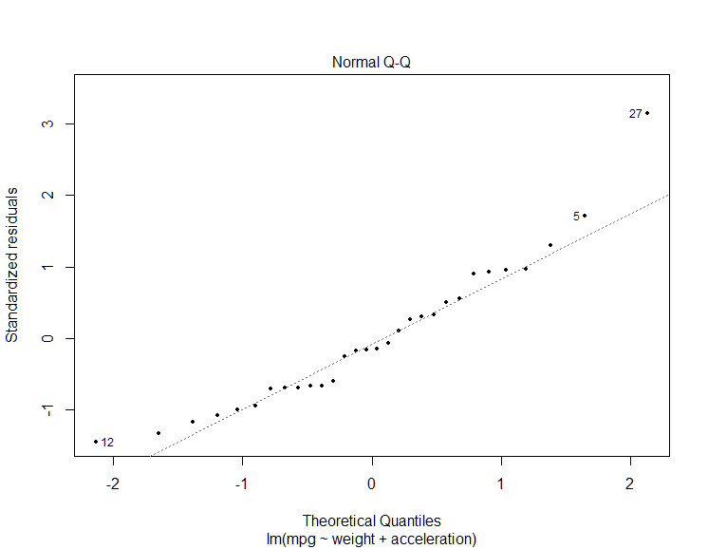
Auto Data: Final Model

Slide 60
Are you satisfied with the multiple regression model assumptions?

Slide 61
Transformation
Sometimes a transformation on the response improves the model fit
Common transformations: Square-root, logarithm(base e), inverse
Instead of regressing the predictors on Y, they are regressed on transformed Y

Slide 62
Transformation Example
Regress 1/MPG on weight and acceleration
Coefficients:
Estimate Std. Error t value Pr(>|t|)
(Intercept) 2.146e-02 9.476e-03 2.264 0.0318 *
weight 1.533e-05 1.981e-06 7.736 2.55e-08 ***
acceleration -1.002e-03 3.707e-04 -2.702 0.0118 *
---
Signif. codes: 0 ‘***’ 0.001 ‘**’ 0.01 ‘*’ 0.05 ‘.’ 0.1 ‘ ’ 1
Residual standard error: 0.005022 on 27 degrees of freedom
Multiple R-squared: 0.7529, Adjusted R-squared: 0.7346
F-statistic: 41.13 on 2 and 27 DF, p-value: 6.377e-09

Slide 63
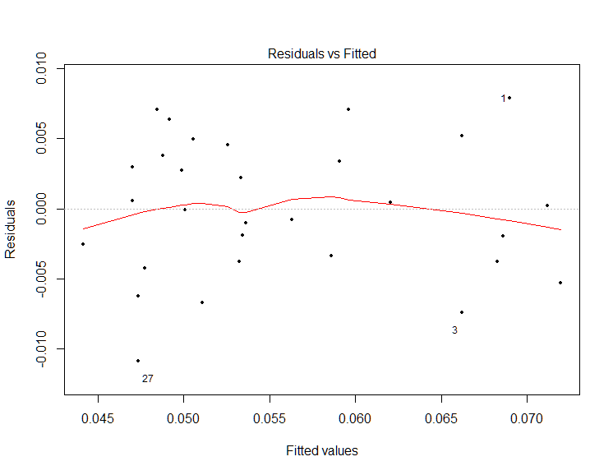
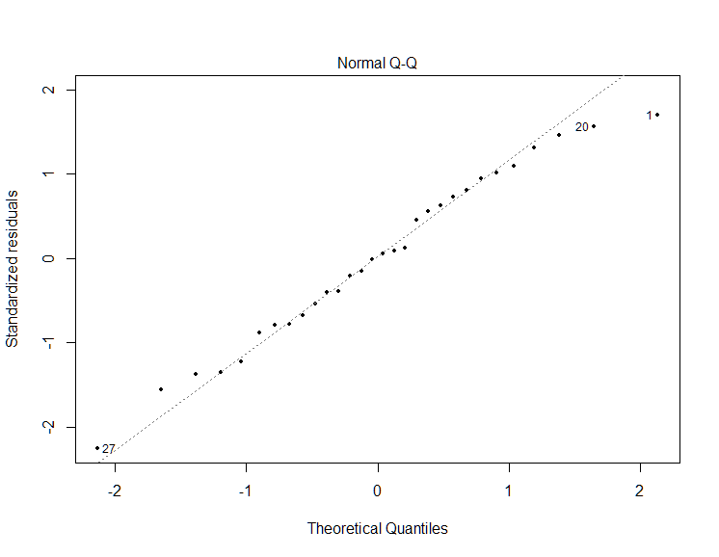
Plots: Inverse Transformation

Slide 64
On Your Own!

Slide 65
Concrete Strength
Concrete compressive strength -- quantitative -- MPa -- Output Variable
Predictors: (Input variables)
Cement -- kg in a m3 mixture
Blast Furnace Slag -- kg in a m3 mixture
Fly Ash -- kg in a m3 mixture
Water -- kg in a m3 mixture
Superplasticizer -- kg in a m3 mixture
Coarse Aggregate -- kg in a m3 mixture
Fine Aggregate -- kg in a m3 mixture
Age --- Day (1~365)

Slide 66
Concrete Strength
Does concrete strength depend on the input variables?
Does concrete strength depend on ALL the input variables?
Is there a multicollinearity problem in the model?
Interpret the regression coefficients? How do changes in the input affect the output?
Do you think if input variables are adjusted arbitrarily, the output variable will go on increasing?
How much of the total variability in the strength is explained by the input variables?
Explore the residuals and decide whether the assumptions are satisfied

Slide 67
Final Model – Comments?

Slide 68
Insurance Claim vs GDP
GDP has an effect on insurance claim for cancer?
Does SpendType (type of insurance) has an effect AFTER the dependency on GDP has been accounted for?
SpendType is a factor variable with 2 levels: Insurance & Public
For a factor (categorical) predictor with K nominal levels, K – 1 dummy variables are introduced
One level is considered baseline

Slide 69
Insurance Claim vs GDP
Coefficients:
Estimate Std. Error t value Pr(>|t|)
(Intercept) -1.454e+04 8.540e+03 -1.703 0.0889 .
PerCapGDP 8.718e+00 1.804e-01 48.335 <2e-16 ***
Spendtypepublic -6.132e+04 3.735e+03 -16.417 <2e-16 ***
---
Signif. codes: 0 ‘***’ 0.001 ‘**’ 0.01 ‘*’ 0.05 ‘.’ 0.1 ‘ ’ 1
Residual standard error: 65760 on 1237 degrees of freedom
Multiple R-squared: 0.6781, Adjusted R-squared: 0.6776
F-statistic: 1303 on 2 and 1237 DF, p-value: < 2.2e-16

Slide 70
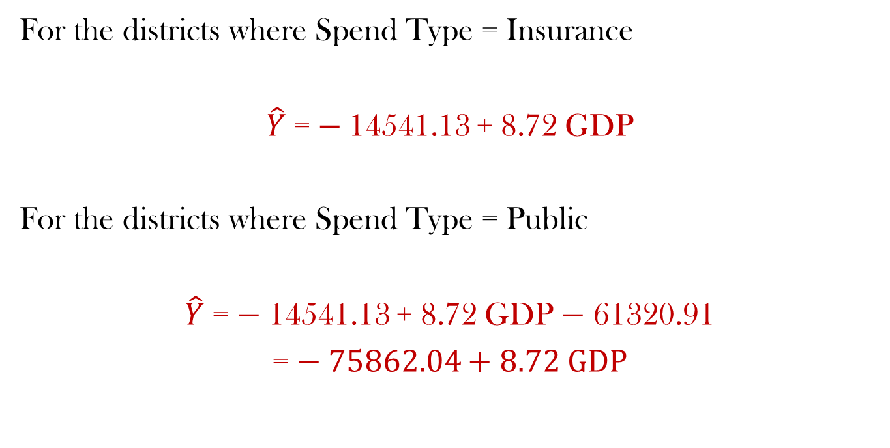
Insurance Claim vs GDP
For the districts where Spend Type = Insurance
$\hat{Y}$ = − 14541.13 + 8.72 GDP
For the districts where Spend Type = Public
$\hat{Y}$ = − 14541.13 + 8.72 GDP − 61320.91
= − 75862.04 + 8.72 GDP

Slide 71
Insurance Claim vs GDP
Does Region has an effect AFTER the dependency on GDP and SpendType has been accounted for?
Region is a factor variable with 4 levels
Coefficients:
Estimate Std. Error t value Pr(>|t|)
(Intercept) 2.259e+05 8.784e+03 25.718 <2e-16 ***
PerCapGDP -1.363e-01 2.751e-01 -0.496 0.62
Spendtypepublic -6.132e+04 2.549e+03 -24.059 <2e-16 ***
RegionNorth 1.371e+05 5.487e+03 24.993 <2e-16 ***
RegionSouth 2.733e+05 7.764e+03 35.196 <2e-16 ***
RegionWest 2.226e+05 6.409e+03 34.742 <2e-16 ***
---
Residual standard error: 44880 on 1234 degrees of freedom
Multiple R-squared: 0.8505, Adjusted R-squared: 0.8499
F-statistic: 1404 on 5 and 1234 DF, p-value: < 2.2e-16

Slide 72
Insurance Claim vs GDP
Write down the multiple regression model
Repeat similar analysis for AvgHeartSpend and AvgOrganSpend
What do you conclude in each case?

Slide 73
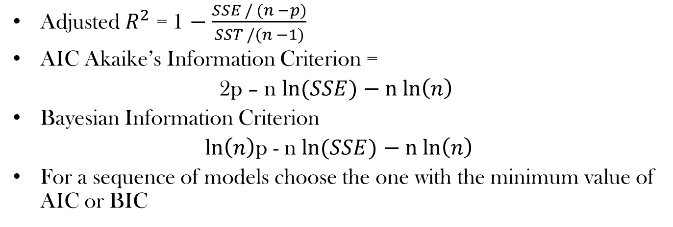
Model Selection
Adjusted $R_{}^{2}$ = 1 − $\frac{SSE / (n −p)}{SST /(n −1)}$
AIC Akaike’s Information Criterion =
2p – n $\ln{(SSE)}$ $− n ln\left(n\right)$
Bayesian Information Criterion
$\ln\left(n\right)$p - n $\ln{(SSE)}$ $− n ln\left(n\right)$
For a sequence of models choose the one with the minimum value of AIC or BIC

Slide 74
Explanation of Carseats Data
It has 400 observations (each at a different store) and 11 variables:
Sales: unit sales in thousands
CompPrice: price charged by competitor at each location
Income: community income level in 1000s of dollars
Advertising: local ad budget at each location in 1000s of dollars
Population: regional pop in thousands
Price: price for car seats at each site
ShelveLoc: Bad, Good or Medium indicates quality of shelving location
Age: age level of the population
Education: education level at location
Urban: Yes/No
US: Yes/No

Slide 75
College Data
A data frame with 777 observations on the following 18 variables.
Private: A factor with levels No and Yes indicating private or public university
Apps: Number of applications received Accept Number of applications accepted
Enroll: Number of new students enrolled
Top10perc / Top25perc Pct.: New students from top 10% / 25% of H.S. class
F.Undergrad / P.Undergrad: Number of full time / part time undergraduates
Outstate: Out-of-state tuition
Room.Board: Room and board costs Books: Estimated book costs
Personal: Estimated personal spending
PhD: Pct. of faculty with Ph.D.’s Terminal: Pct. of faculty with terminal degree
S.F.Ratio: Student/faculty ratio
perc.alumni: Pct. alumni who donate
Expend Instructional expenditure per student
Grad.Rate Graduation rat

Slide 76
Demo with R
#### Model Selection with Concrete Data ####
null=lm(CompStrength~1, data=Concrete_Data)
Concrete.fit1=lm(CompStrength~., data=Concrete_Data)
Concrete.fit4 <- step(null, scope=list(lower=null, upper=Concrete.fit1), direction="forward")
Concrete.fit5 <- step(null, scope=list(lower=null, upper=Concrete.fit1), direction="both")

Slide 77
Demo with R
library(leaps)
Concrete.fit6=regsubsets(CompStrength~., data=Concrete_Data, nbest=3)
plot(Concrete.fit6, scale="adjr2")
plot(Concrete.fit6, scale="bic")

